Slide 1
A SOLID ride with .NET Design Patterns
Jon Bulmer
Software Developer
InTouch Business
18 years and counting
From COBOL to C#

Slide 2
We Are Recruiting
ASP.NET MVC
Entity Framework
C#

Slide 3
Reason for the talk
It is just important to follow good coding practice
It can be hard to find examples of SOLID practises
Its fun to write code

Slide 4
Work ethic
Your career is your responsibility
Give you employer 40 hours and 20 hours for your Learning
56 hours for sleep and 52 for everything else

Slide 5
How we sometime work
We are under pressure to get the job done
Stack over flow
Cut and paste code
Demo code is only designed to explain one issue

Slide 6

Some books we could read

Slide 7
An over view of the train ride demo
A system of trains running around a network
Using the SOLID principles as our guide to coding
Dependence Injection
Test Driven Development
Domain Driven Development
The 3 laws of TDD

Slide 8
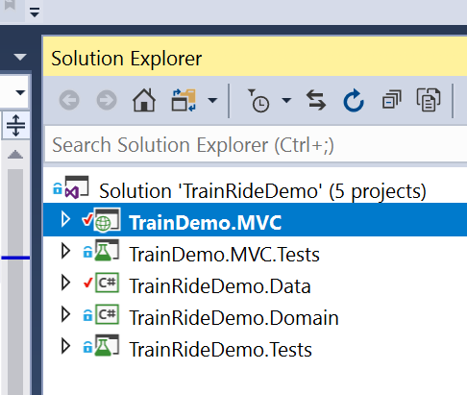
First look at the Application

Slide 9
The SOLID principles
Single Responsibility Principle
Open for extension closed for change Principle
Liskov Substitution Principle
Interface Segregation Principle
Dependence Inversion Principle

Slide 10
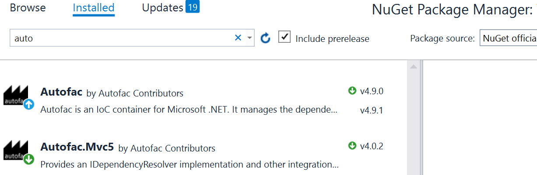
Dependency Injection
Using Auto Fac
Gives us full control over how we call our classes and makes code Testable
Set it up.

Slide 11
Test Driven Development
Getting the job done
No production code until a failing test has been wrote
Do not write any more of a unit test than is sufficient to fail
Do not write any more production code until all the tests pass

Slide 12
Domain Driven Design
Why should we use DDD?
What does a DDD solution look like?
Managing Complexity using DDD

Slide 13
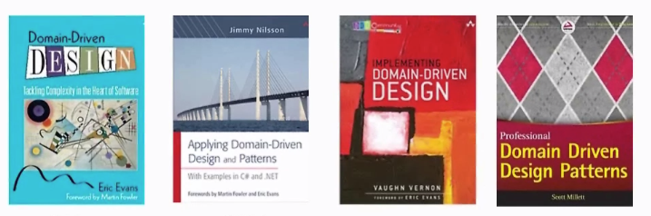
Books on Domain Driven Design

Slide 14
Why use DDD
Principles and patterns
History of success with complex projects
Aligns with practises from the experiences of our industry
Clear, testable code that represents the domain

Slide 15
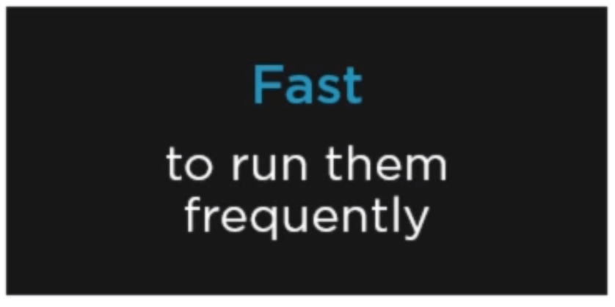
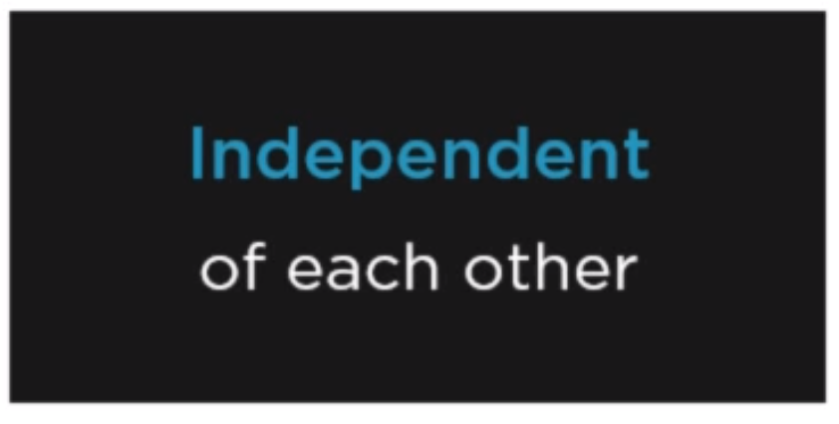
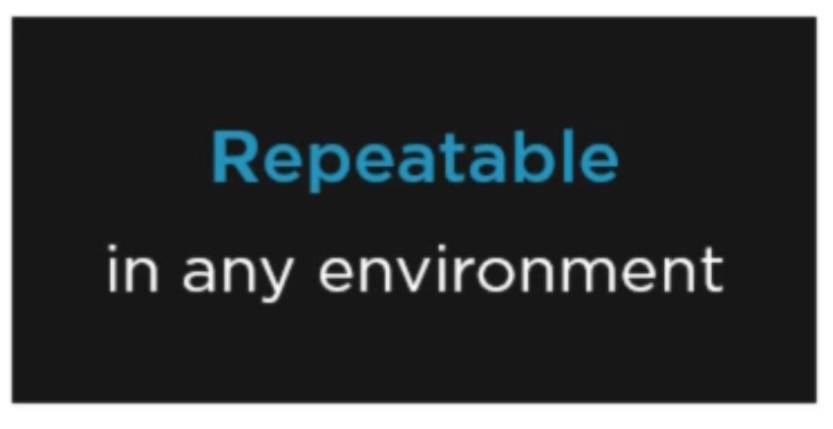
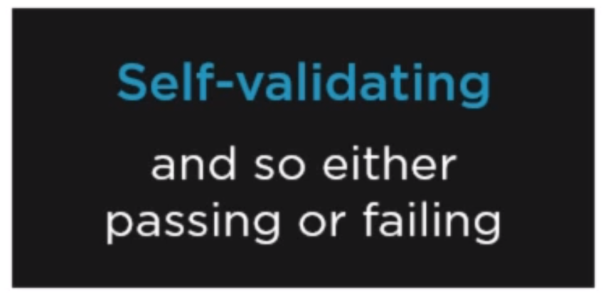
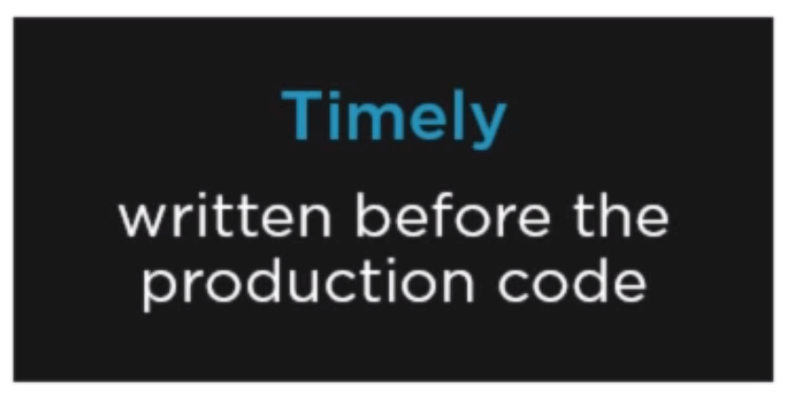
Unit testing
Effective unit test and the F.I.R.S.T mnemonic

Slide 16
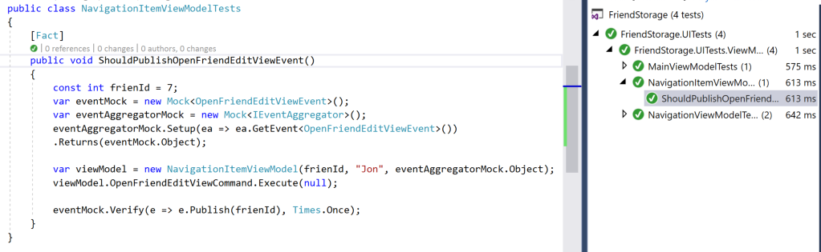
Friends Storage Test cycle demo
With thanks to Thomas Cludius Huber
Pluralsight WPF and MVVM: Test Driven Development of ViewModels
I am using this demo due to time constraints on developing my solution.

Slide 17
Design spike
When you need to experiment on how to do something
Write some code to prove your concept
Then disregard it and start writing Your TTD code

Slide 18
Take a look at the demo application
The application in the first case is separated out into folder
Thinking of using namespaces to keep different parts of the domain separate
Introduce projects as you identify different parts of the domain.
Evolve the logic as it develops keeping the domain in mind
DDD is not a hard and fast rule, keep it in mind and take time to think does my code have a smell of not following patterns from time to time.

